Slide 1

SMART DOOR LOCKING SYSTEM USING FACE RECOGNITION BATCH:02
Under the Guidance of:- presented by:-
DR.Ramakrishnan R Chavali Rahul :191FA07072
Mr.P.Ramdoss Valeti Vishnu Vivek :201FA07053
Juhi Kumari :201FA07075

Slide 2
Contents
Abstract
Introduction
Existing System
Proposed System
Hardware and Software Requirements
Working
Block Diagram
Architecture
Future Work
Conclusion

Slide 3
Abstract
In this system we have proposed face recognition door lock system using Arduino for security purpose. Implementation of the system is for monitoring whether any unknown person is entering in to the door. We have established communication with electronic devices through face detection with the help of ESP-32 camera Arduino platform.
As soon as the person enters near the door, ESP-32 camera captures the image and face detection process is done then if it matches with database images then the door is unlocked otherwise a message with the picture of a person will be sent to the registered mobile.

Slide 4
Introduction
Nowadays, as the technology is increasing, facilities for human beings are increasing. In day to day activities, life of people has become very easier with the incorporation of many technologies. On the other hand, it also creates security issues . The traditional door locks have a problem that almost anyone can break and enter into your house. Hence it is a great challenge to overcome these problems. In general, in order to secure home, people make use of CCTV. Images will store in the database, so that the action can be taken when any suspicious incident happens.

Slide 5
Existing system
For the most part, customary locks are substantial and that are not solid as they can harm basically by utilizing a few apparatuses. With these kinds of locks there is no security. Some of the door locking system is also existed but it does not deal with more security. And also it is not more flexible .

Slide 6
Proposed System
The main objective of this project is to enhance the security of the door locking system . In our proposed system we are going to use ESP32-CAM which is used take some pictures of the users and store those pictures in database .when the user face is recognized it will automatically open the lock. If some unauthorized person try to unlock the door it will send the message to registered mobile number.

Slide 7
Hardware and software Requirements
Hardware Requirements:-
1.Arduino UNO Board
2.TTL Programmer
3.Relay Module
4.LED
5.Solenoid Lock
6.Jumper Wires
7.ESP32-CAM
8.12 V Battery 9.Regulator 10.Capacitor 11.Breadboard

Slide 8
Hardware and software Requirements
Software used:-
1.Arduino IDE
2.Firebase Database

Slide 9
Working
This part covered the essential settings including the ESP32 Camera board manager installation. The system is powered by ESP 32 CAM circuit. The Circuit Diagram for ESP32-CAM Faces Recognition Door Lock System is combined with an TTL Programer, Relay Module, and Solenoid Lock. The UNO board is employed to flash the code into ESP32-CAM while the relay module is employed to modify the Solenoid lock on or off. Here Arduino IDE is employed to program ESP32-CAM.

Slide 10
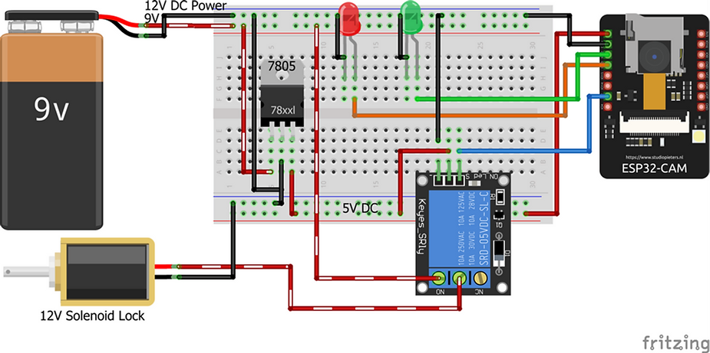
Block Diagram

Slide 11
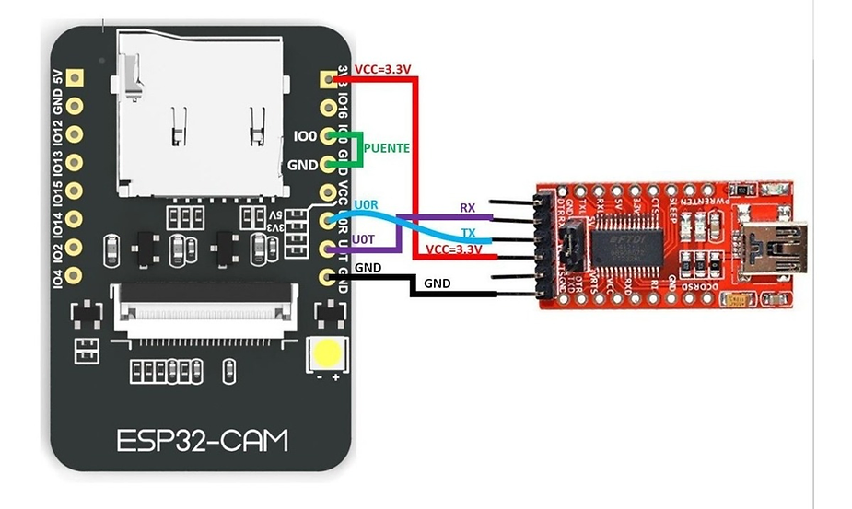
Block Diagram

Slide 12
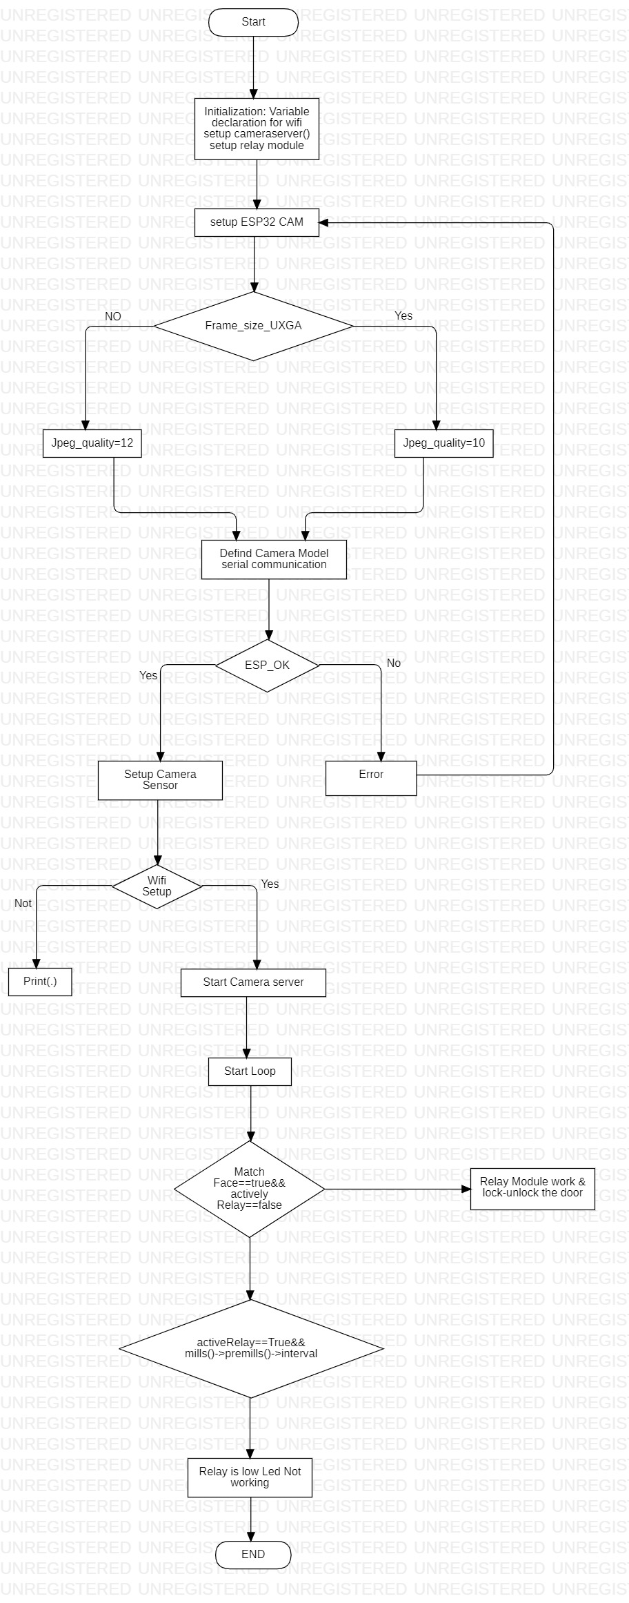

Slide 13
The Architecture
Main features of the door lock system:-
There are several features of the door lock system. It helps to lock and unlock the doors from face recognition with the help of whatever images is stored in the database by ESP32-CAm. It has a monitoring system, which can uniquely monitor every actions performed. The system can monitor the last person who locked the and unlocked door . With such features implanted, it enhances the security system of the place. The admins can track and monitor every single activity on-the-go.

Slide 14
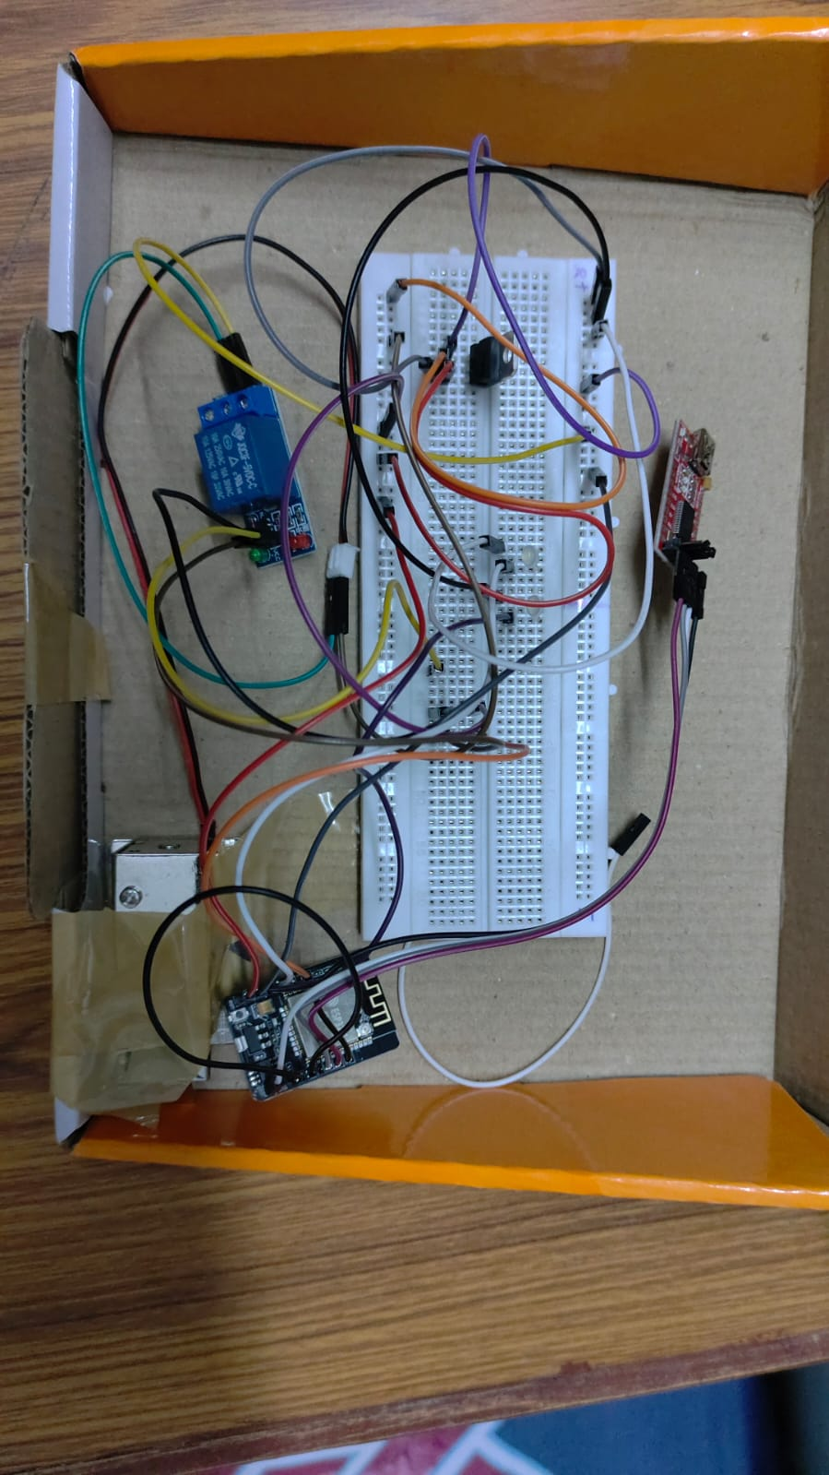
Results

Slide 15
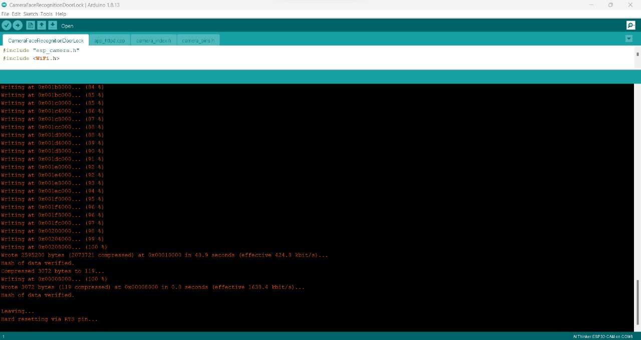
Results

Slide 16
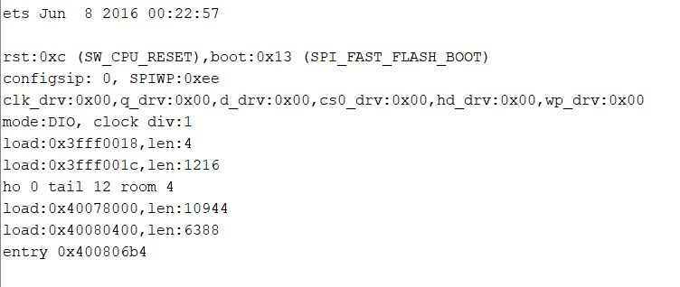
Results

Slide 17
Future Work
There are several other features those will be integrated in the future aiming to solve many problems and advancements. The features to be integrated in future is an impact detection sensor, which is capable of detecting any kind of physical impact made on the door and raising an alarm on the admin’s mobile device. Users can add new doors or remove them accordingly. It eliminates the hassle of carrying several keys and more importantly the problems of losing keys.

Slide 18
Conclusion
In this system we have implemented a face recognition door lock system. Recognizing of faces is done by using cascade classifiers, which gets a high accuracy and will store in the database. For this testing, we have used 5 images only. Computer vision is used in the IOT. For security purpose, we have implemented real time face detection by Haar classifier. Thus this system can useful for senior citizens living alone and for immobilized people. Hence the proposed system is practically easy to construct and easy to track the path.

Slide 19


